Slide 1
Transformation
‹#›

Slide 2
What is a Transformation
Transformation:
An operation that changes one configuration into another
For images, shapes, etc.
A geometric transformation maps positions that define the object to other positions
Linear transformation means the transformation is defined by a linear function... which is what matrices are good for.
‹#›

Slide 3
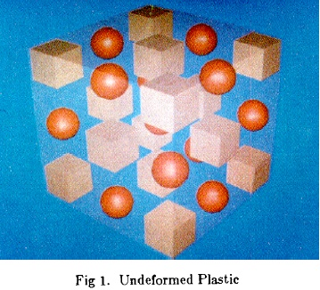
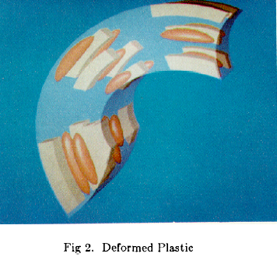

What is a Transformation?
A function that maps points x to points x':
Applications: animation, deformation, viewing, projection, real-time shadows, …
‹#›

Slide 4
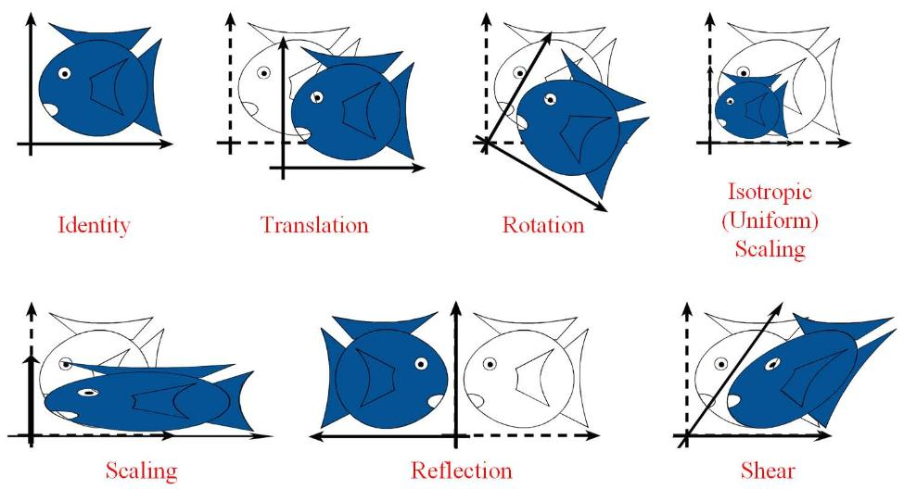
Examples of Transformation
‹#›

Slide 5
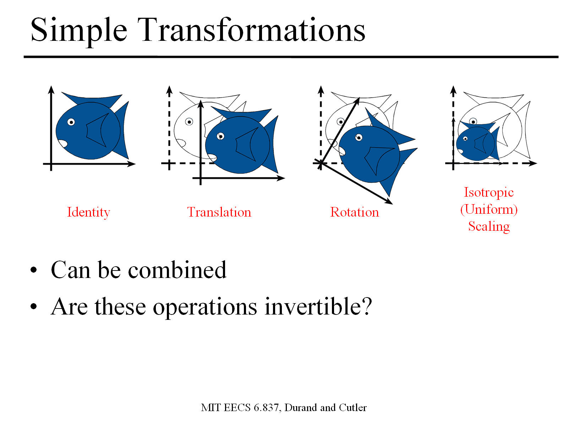
Simple Transformations
Can be combined
Are these operations invertible?
Yes, except scale = 0
‹#›
Notes:
‹#›

Slide 6
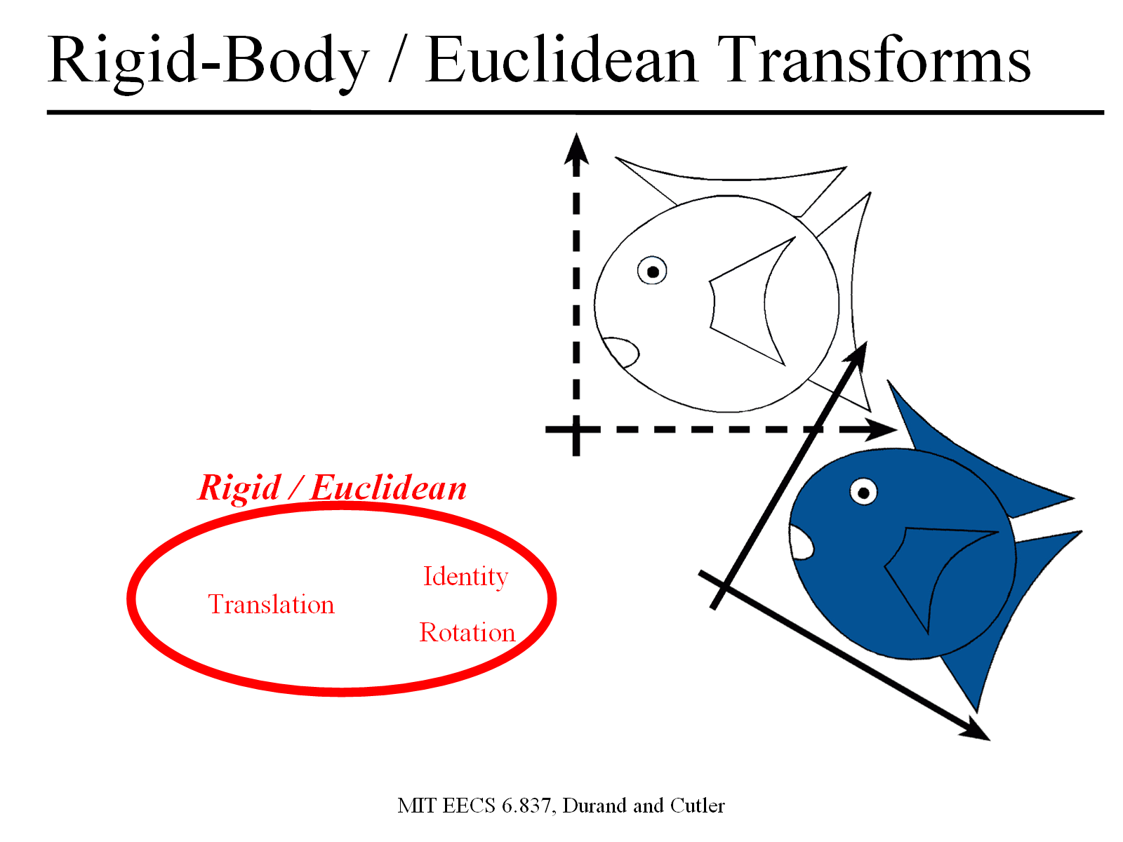
Rigid-Body / Euclidean Transforms
Preserves distances
Preserves angles
Rigid / Euclidean
Identity
Translation
Rotation
‹#›
Notes:
‹#›

Slide 7
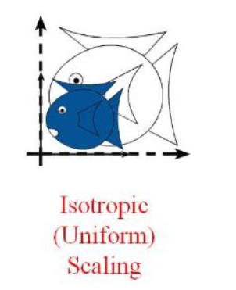
Similitudes / Similarity Transforms
Preserves angles
Similitudes
Rigid / Euclidean
Isotropic Scaling
Identity
Translation
Rotation
‹#›
Notes:
‹#›

Slide 8
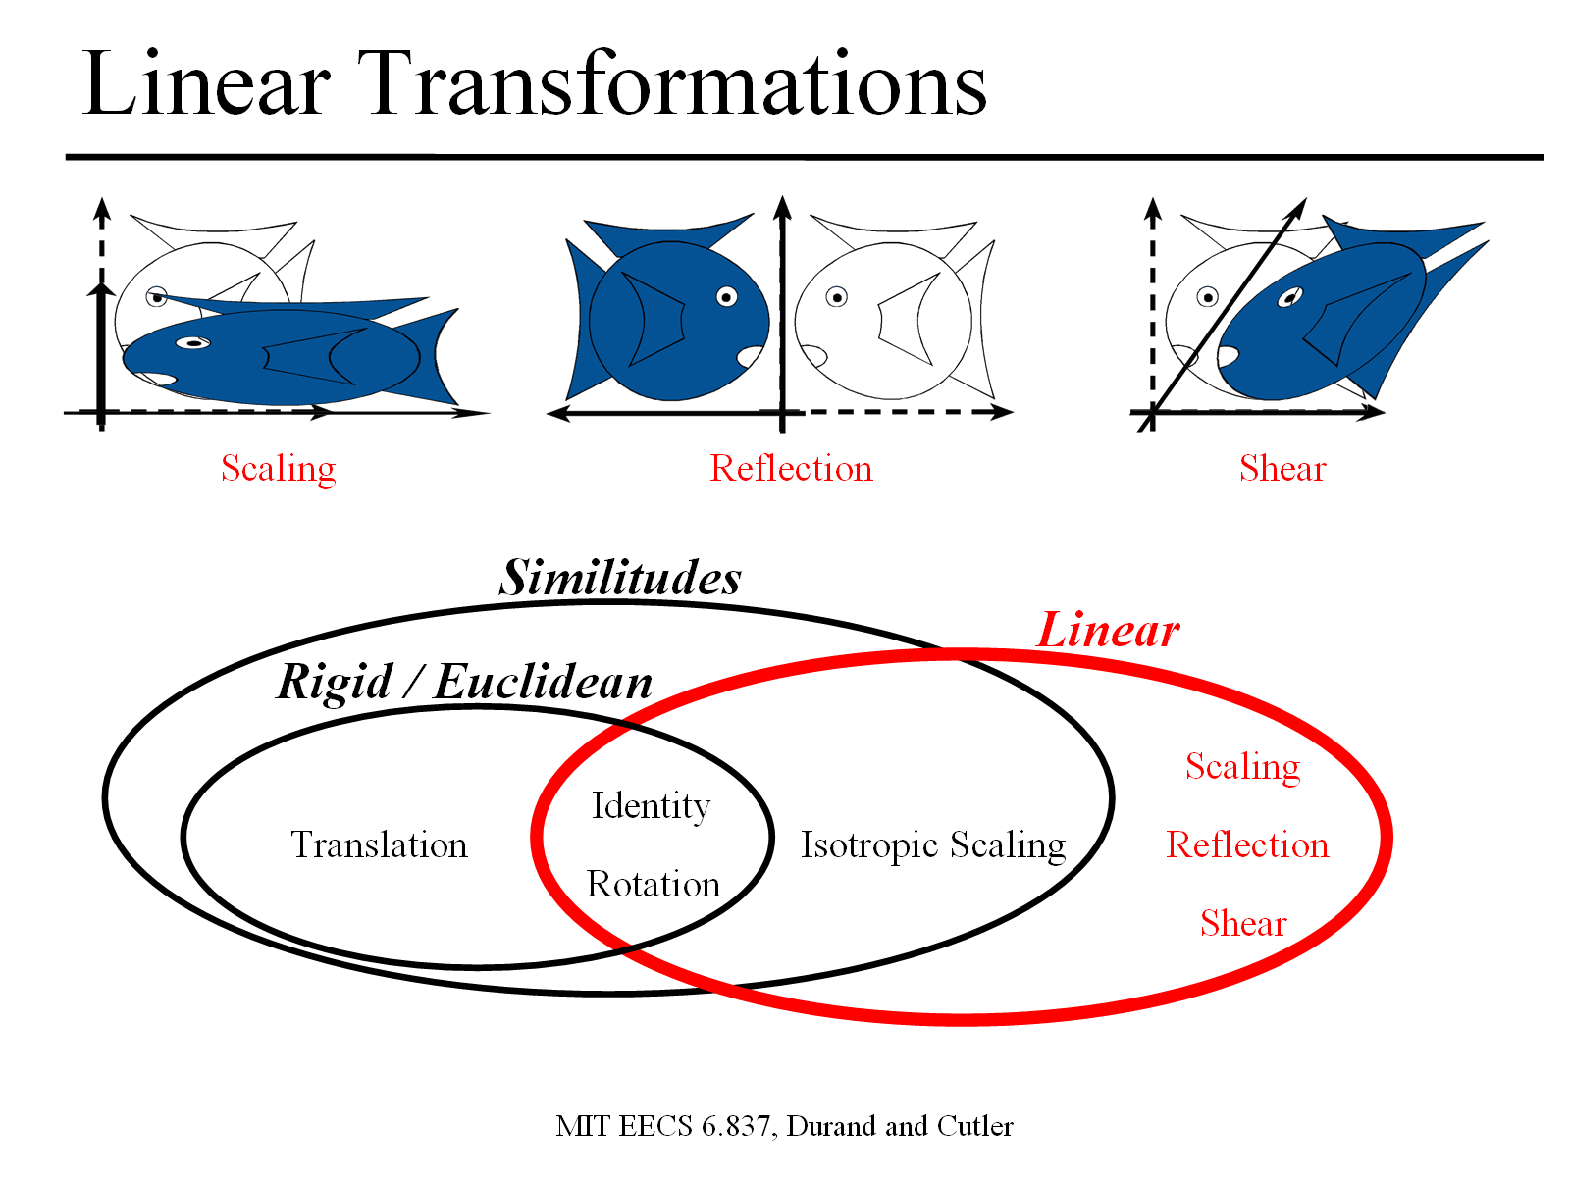
Linear Transformations
Similitudes
Linear
Rigid / Euclidean
Scaling
Identity
Translation
Isotropic Scaling
Reflection
Rotation
Shear
‹#›
Notes:
‹#›

Slide 9
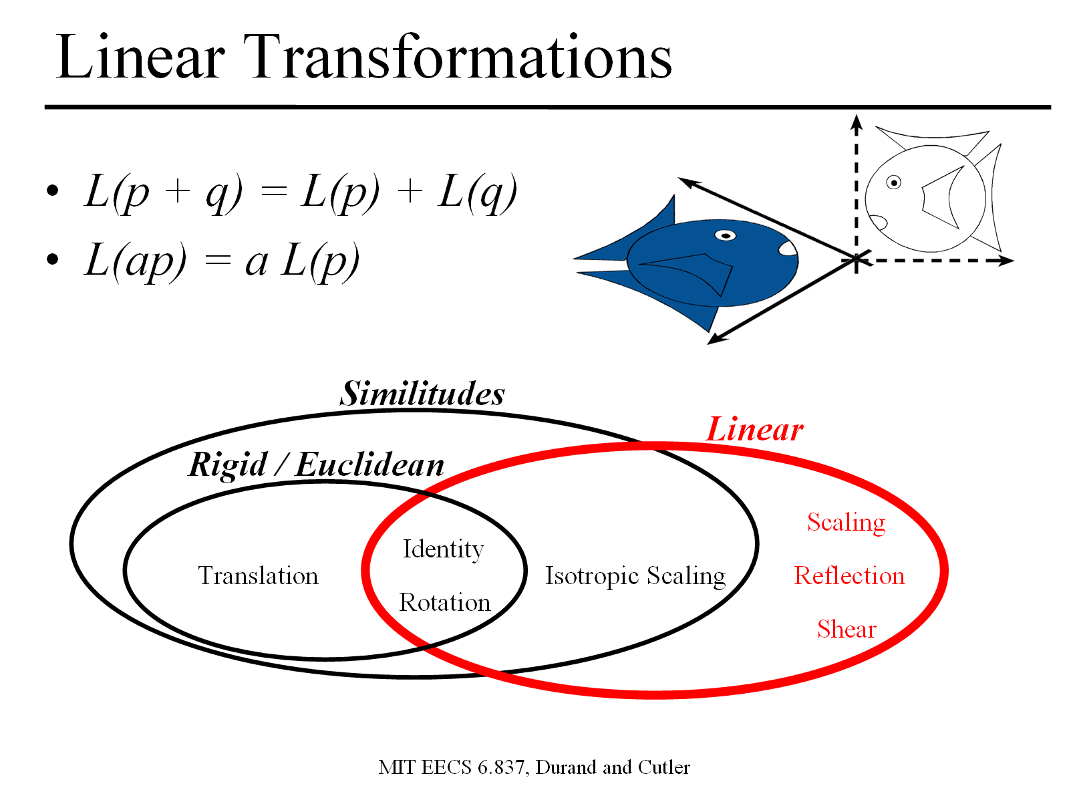
Linear Transformations
Additivity: L(p + q) = L(p) + L(q)
Homogeneity: L(ap) = a L(p)
Similitudes
Linear
Rigid / Euclidean
Scaling
Identity
Translation
Isotropic Scaling
Reflection
Rotation
Shear
‹#›
Notes:
‹#›

Slide 10
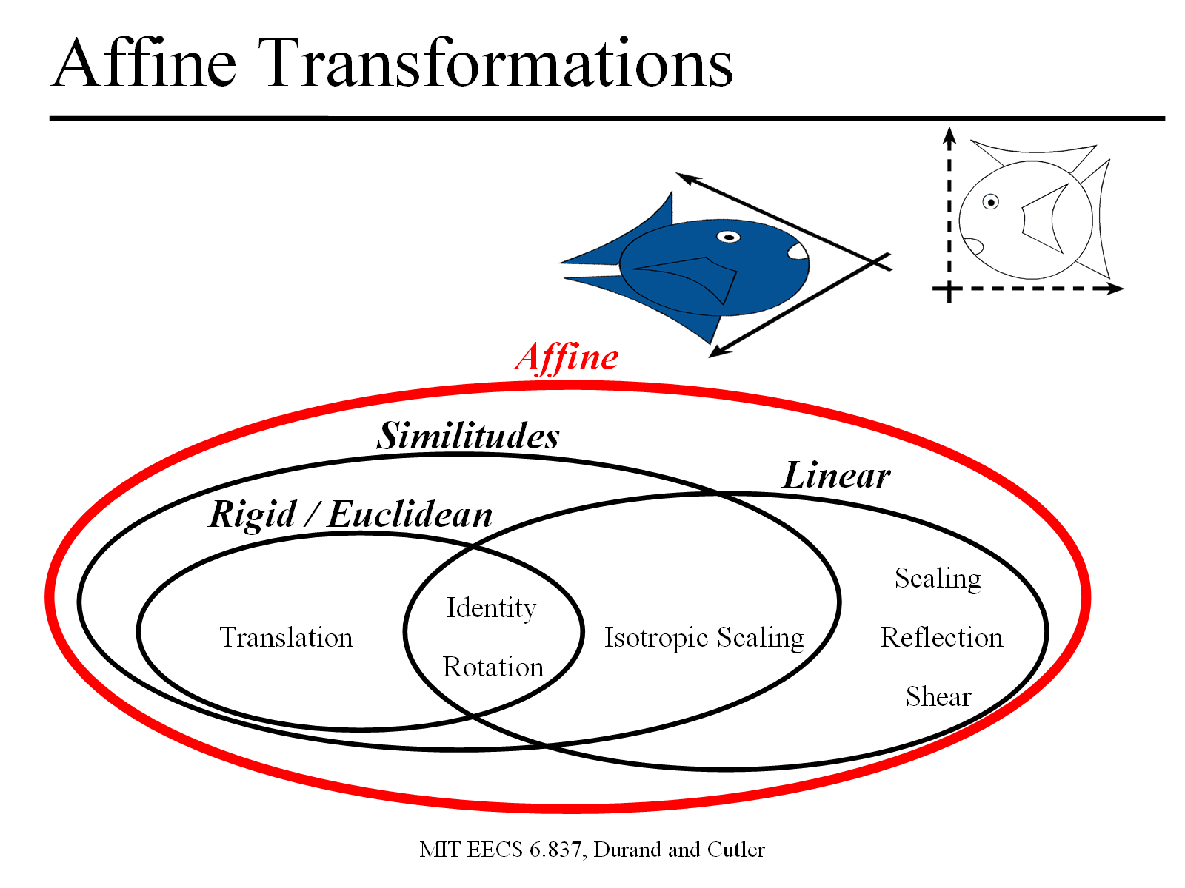
Affine Transformations
preserves parallel lines
Affine
Similitudes
Linear
Rigid / Euclidean
Scaling
Identity
Translation
Isotropic Scaling
Reflection
Rotation
Shear
‹#›
Notes:
‹#›

Slide 11
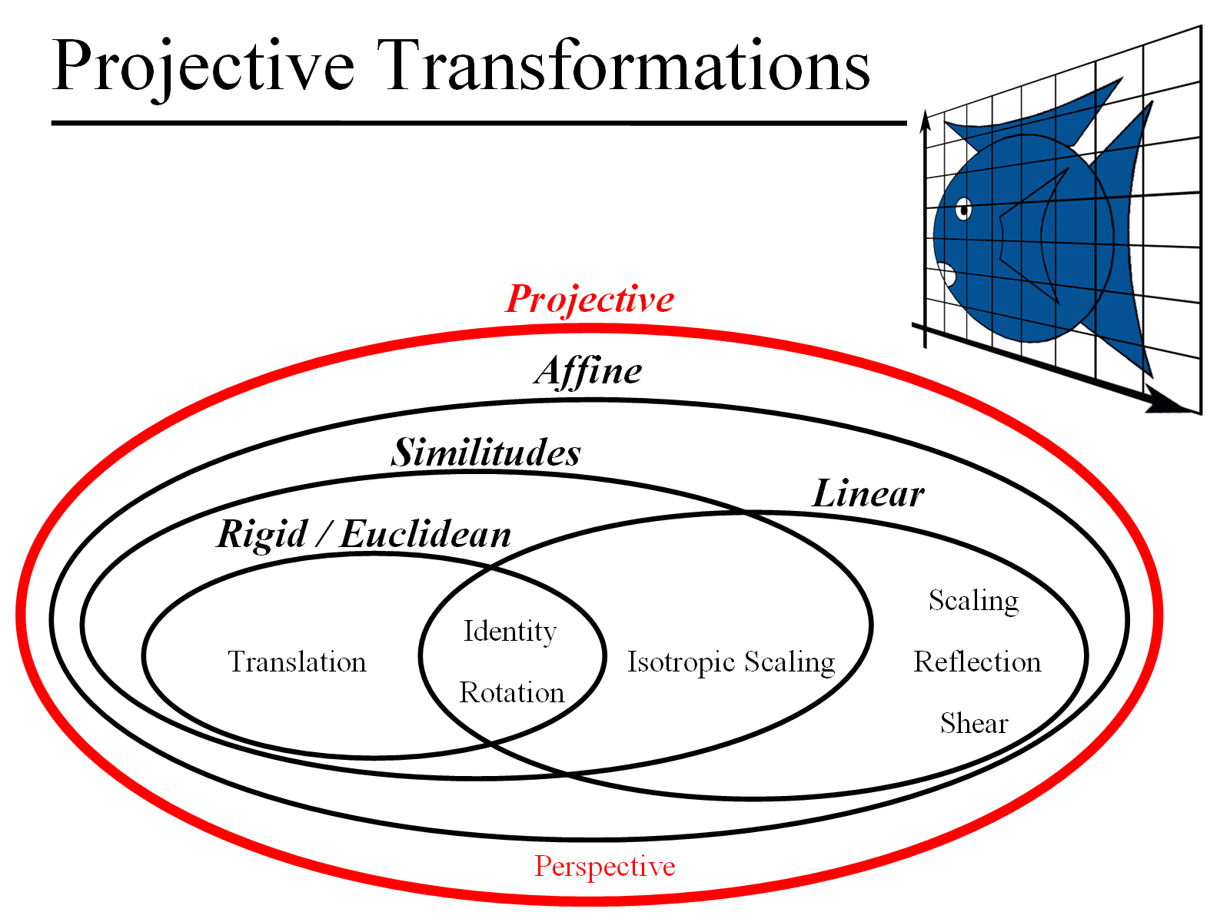
Projective Transformations
preserves lines
Projective
Affine
Similitudes
Linear
Rigid / Euclidean
Scaling
Identity
Translation
Isotropic Scaling
Reflection
Rotation
Shear
6.837 Fall 06 – Durand
Perspective
‹#›
Notes:
‹#›

Slide 12
How are Transforms Represented?
x' = ax + by + c
y' = dx + ey + f
x'
y'
a b
d e
x
y
c
f
=
+
p' = M p + t
‹#›
Notes:
‹#›

Slide 13
Translation in homogeneous coordinates
x' = ax + by + c
y' = dx + ey + f
Homogeneous formulation
Cartesian formulation
x'
y‘
1
a b
d e
0 0
c
f
1
x
y
1
x'
y'
a b
d e
x
y
c
f
=
=
+
p' = M p + t
p' = M p
‹#›
Notes:
‹#›

Slide 14
Homogeneous Coordinates
Translation, scaling and rotation are expressed (non-homogeneously) as:
translation: P′ = P + T
Scale: P′ = S · P
Rotate: P′ = R · P
Composition is difficult to express, since translation not expressed as a matrix multiplication
Homogeneous coordinates allow all three to be expressed homogeneously, using multiplication by 3 × 3 matrices
W is 1 for affine transformations in graphics
‹#›
Notes:
Only linear of points is valid in an affine combination
‹#›

Slide 15
Homogeneous Coordinates
Add an extra dimension
in 2D, we use 3 x 3 matrices
In 3D, we use 4 x 4 matrices
Each point has an extra value, w
x'
y'
z'
w'
a
e
i
m
b
f
j
n
c
g
k
o
d
h
l
p
x
y
z
w
=
p' = M p
‹#›
Notes:
‹#›

Slide 16
Homogeneous Coordinates
Most of the time w = 1, and we can ignore it
If we multiply a homogeneous coordinate by an affine matrix, w is unchanged
x'
y'
z'
1
a
e
i
0
b
f
j
0
c
g
k
0
d
h
l
1
x
y
z
1
=
‹#›
Notes:
‹#›

Slide 17
Homogeneous Coordinates
P_{2d} is a projection of P_{h} onto the w = 1 plane
So an infinite number of points correspond to : they constitute the whole line (tx, ty, tw)
w
P_{h}(x,y,w)
w=1
P_{2d}(x,y,1)
y
x
‹#›

Slide 18
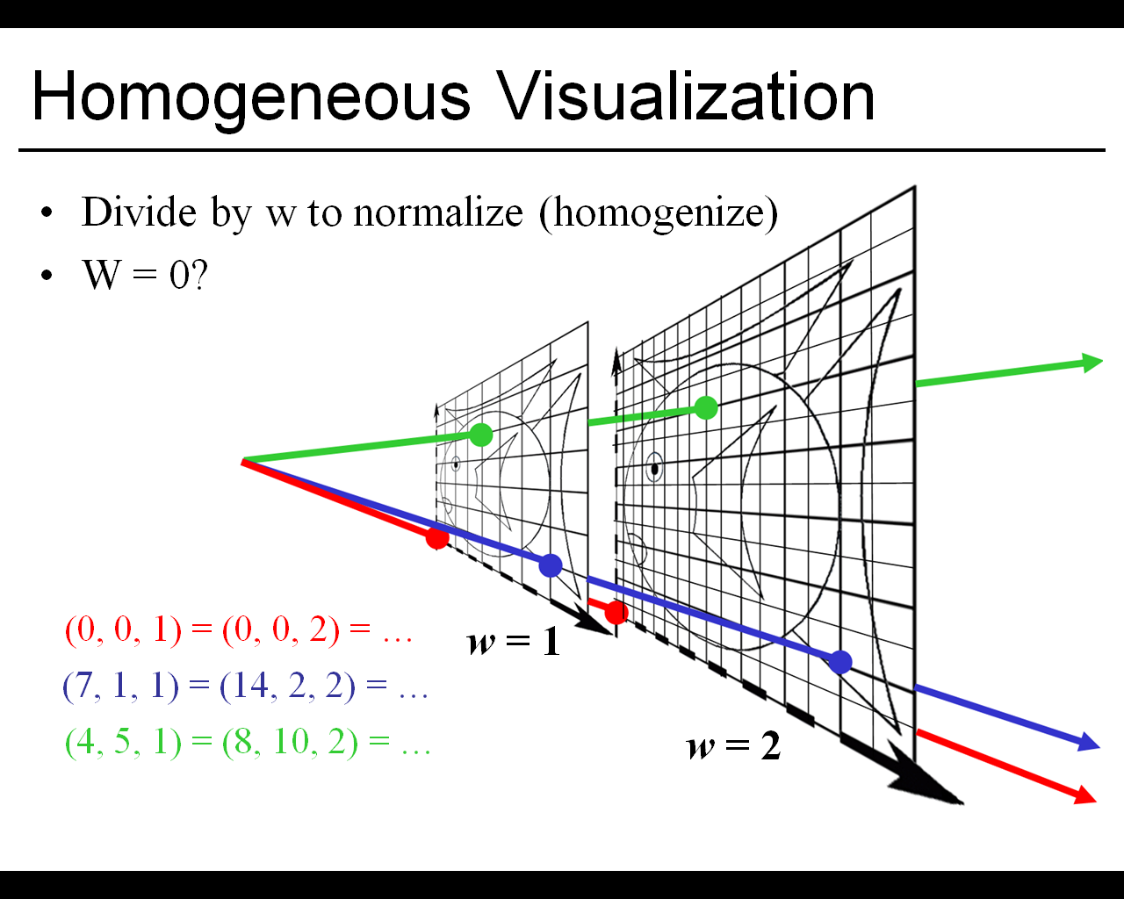
Homogeneous Visualization
Notes:
‹#›

Slide 19
Mechanics of Rigid Transformations
Translate
Rotate
Scale
‹#›
Notes:
https://www.youtube.com/watch?v=E3Phj6J287o&list=PLMZnvBHNk2GWK8i1lcxx4exUXjtK8QSgK&index=13

Slide 20
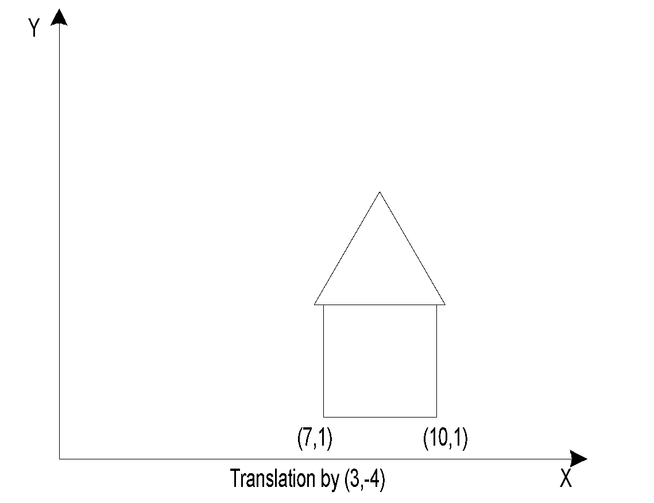
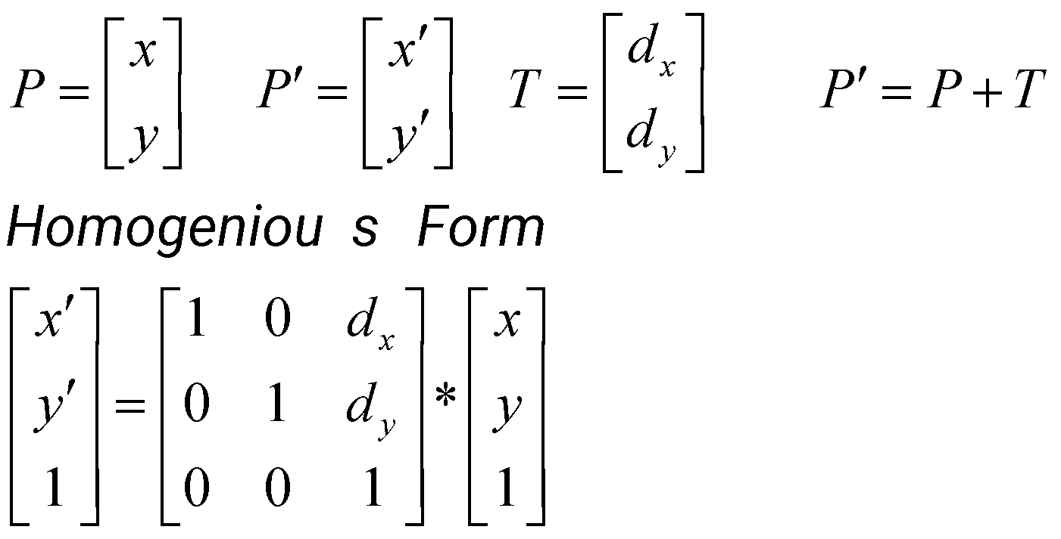
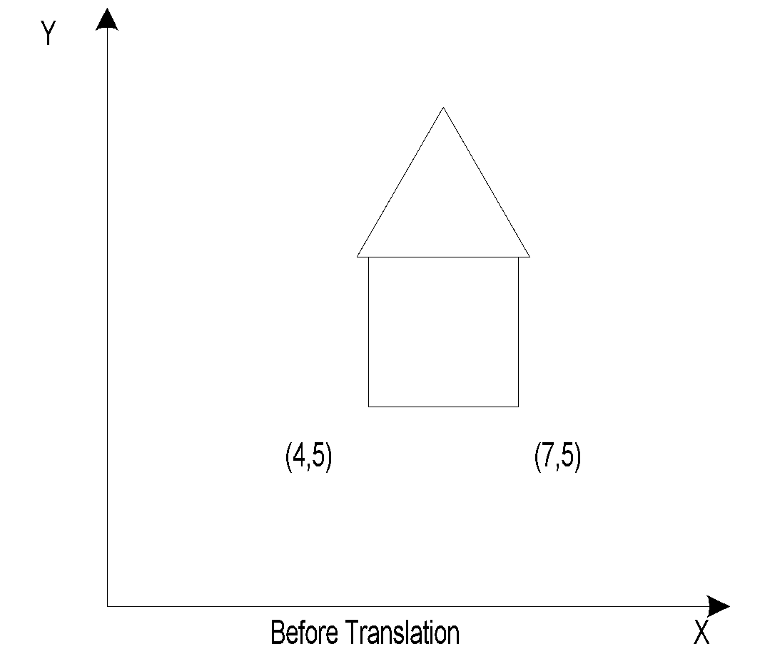
Translation – 2D
x’ = x + d_{x}
y’ = y + d_{y}
‹#›
Notes:
‹#›

Slide 21
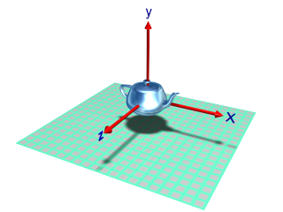
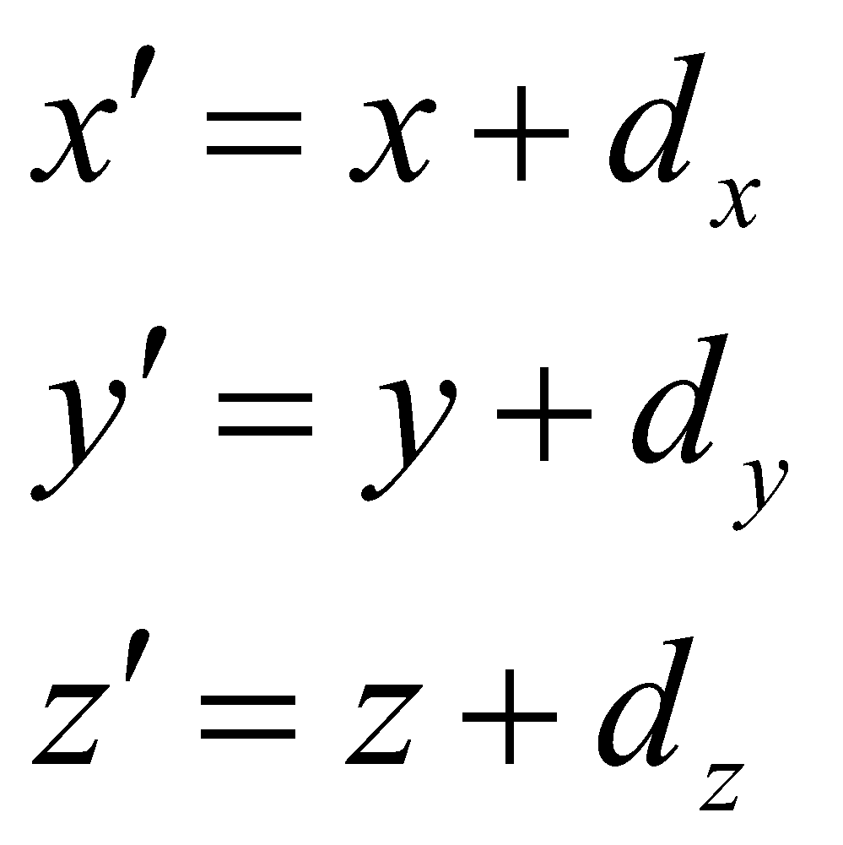
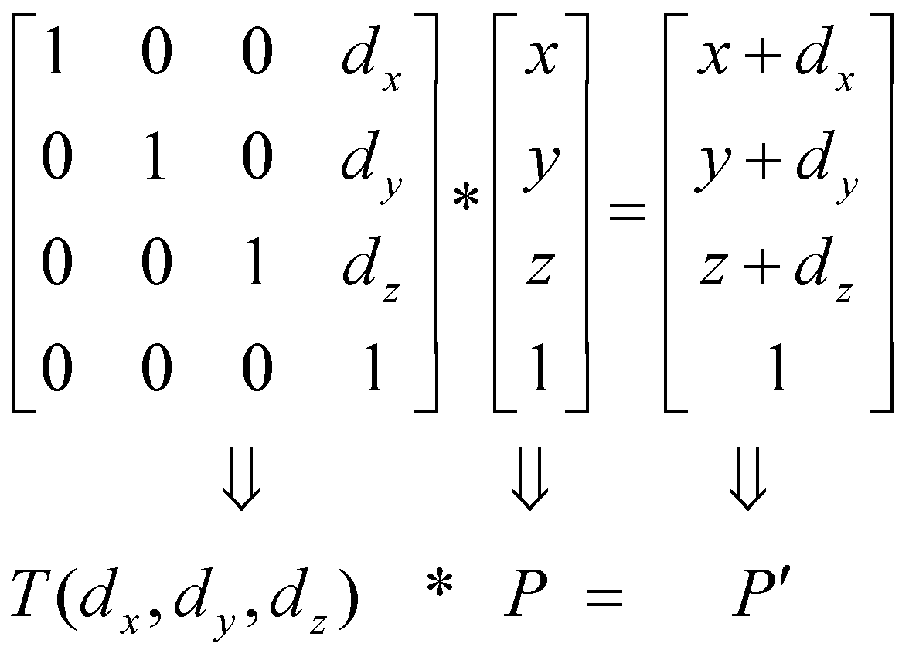
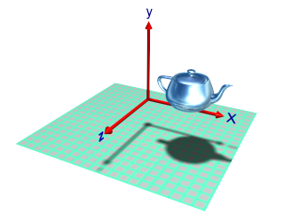
Translation – 3D
‹#›

Slide 22
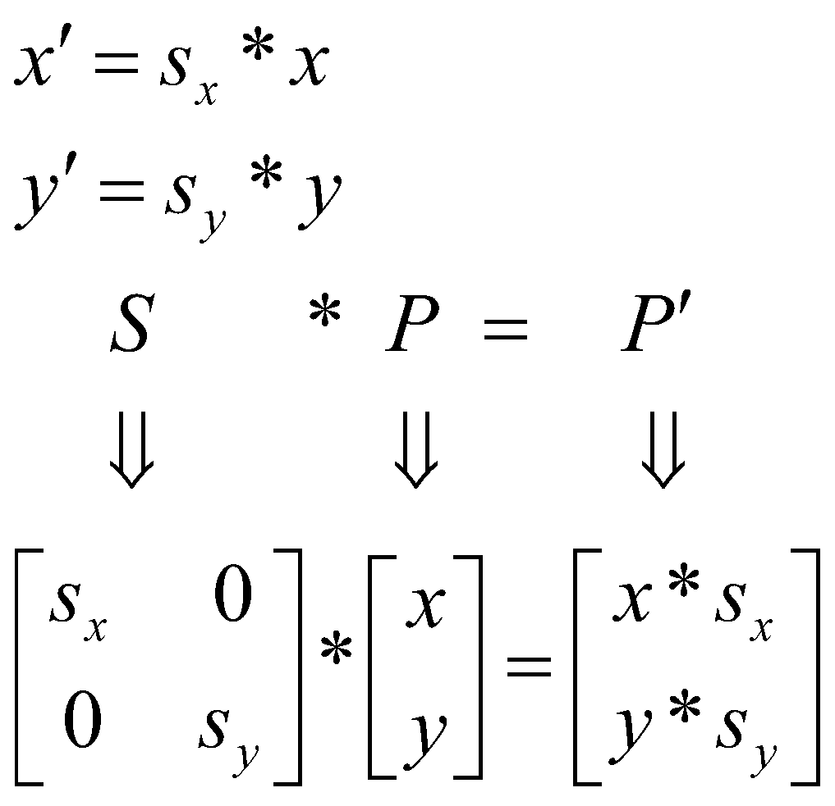
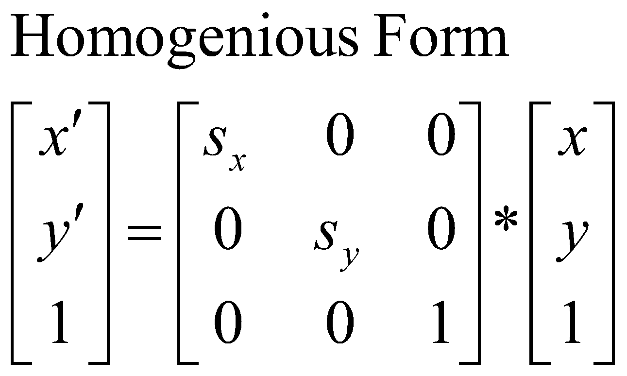
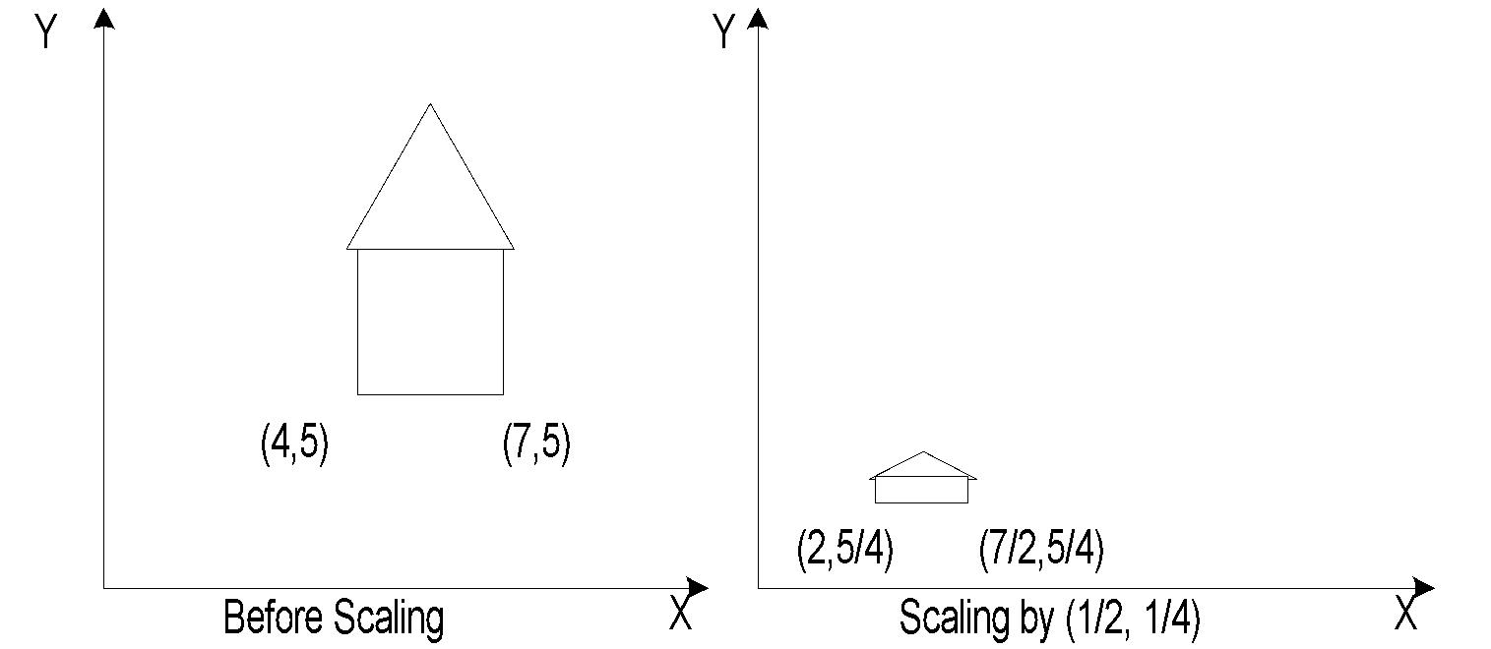
Scaling – 2D
Types of Scaling:
Differential ( s_{x} != s_{y} )
Uniform ( s_{x} = s_{y} )
‹#›

Slide 23
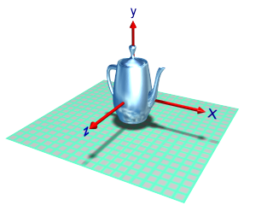
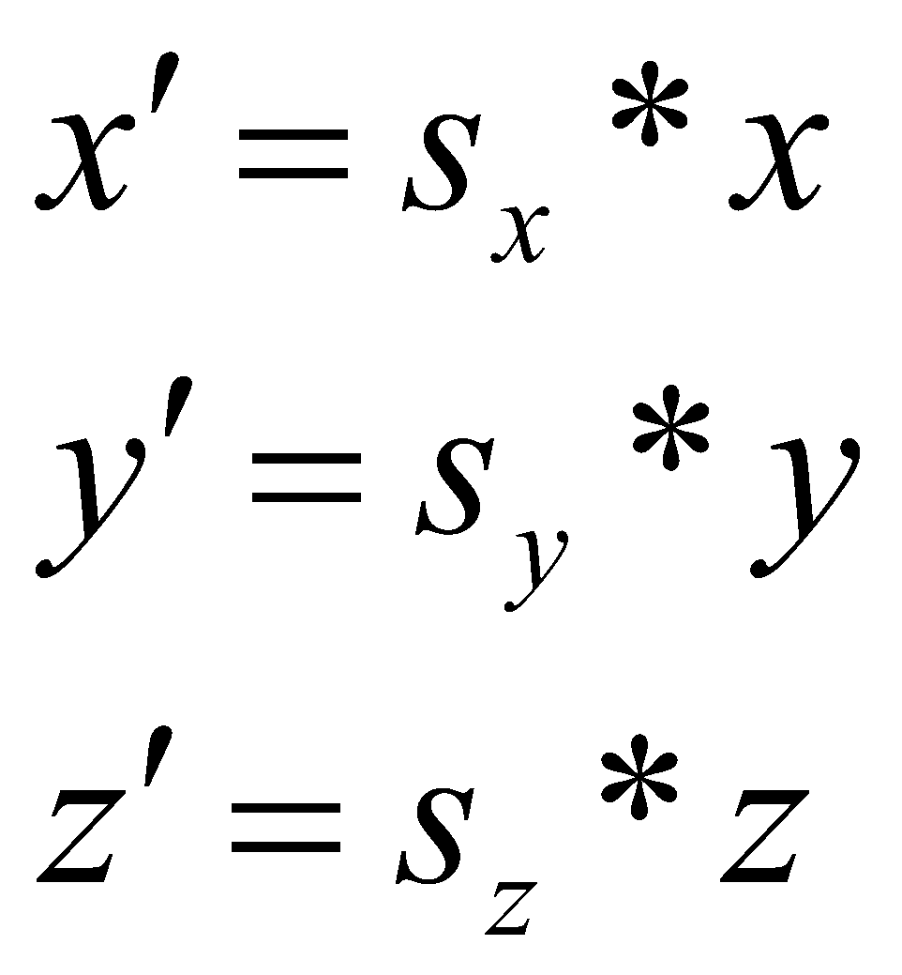
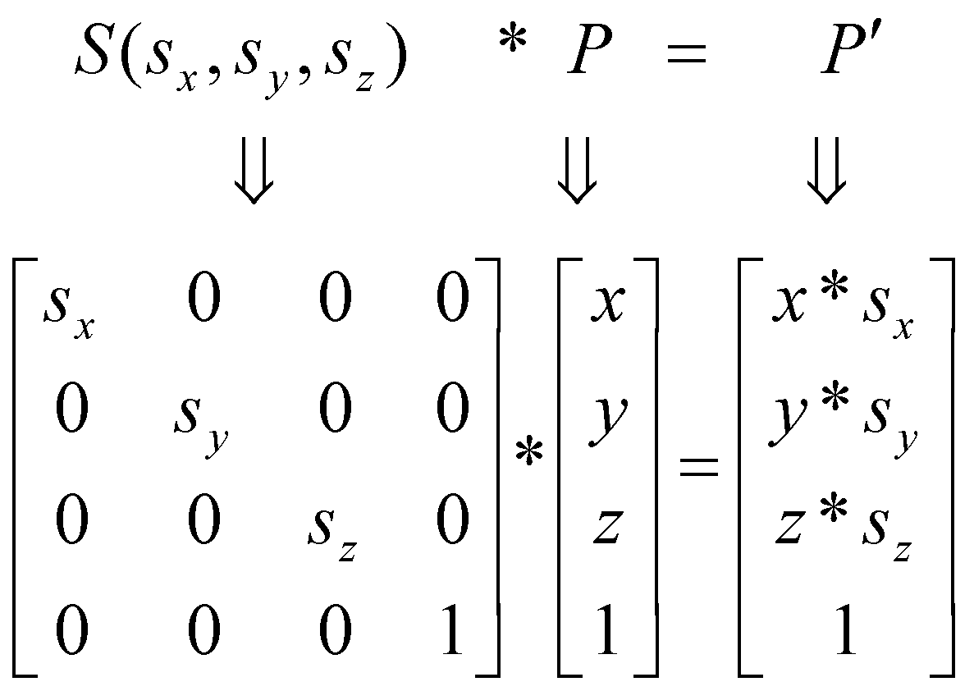
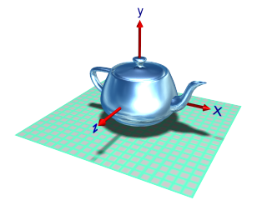
Scaling – 3D
Original
scale Y axis
scale all axes
‹#›

Slide 24
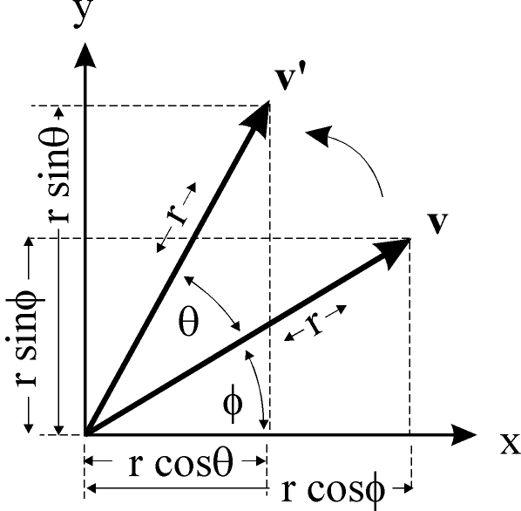
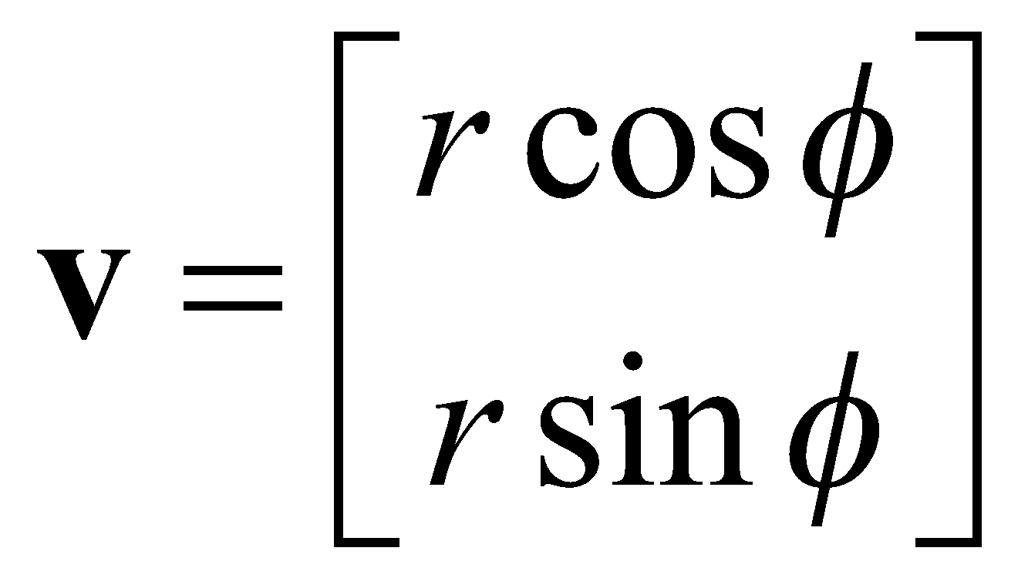
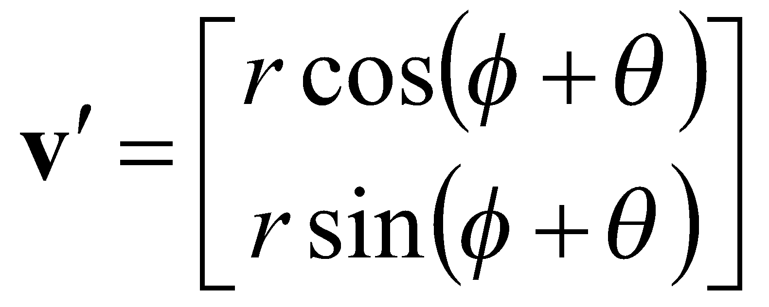
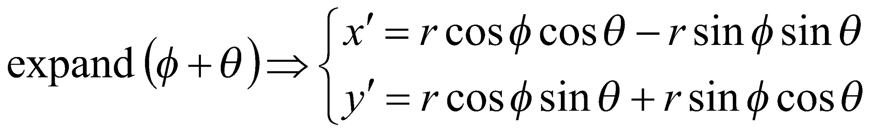
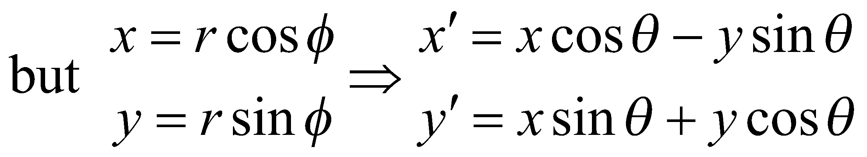
Rotation – 2D
rotated
original

Slide 25
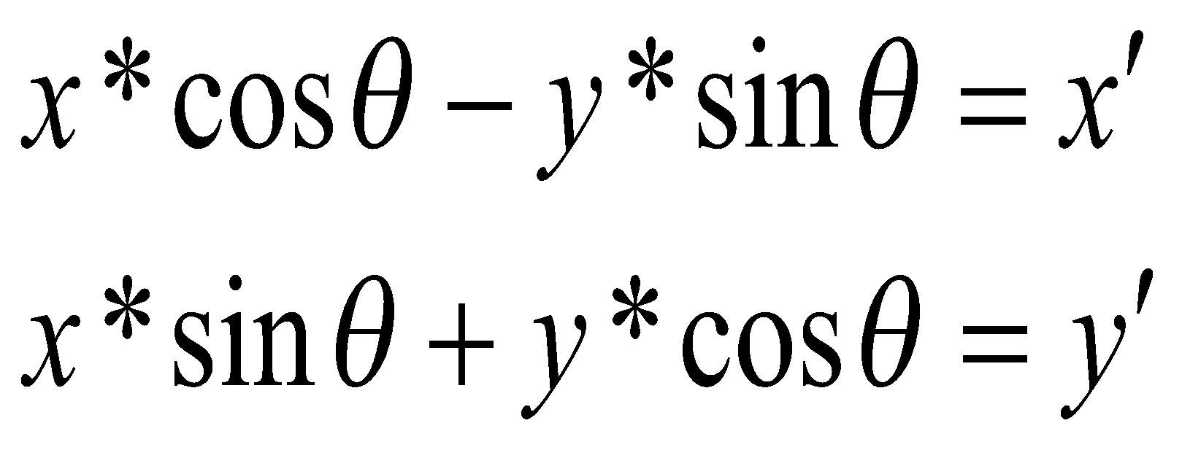
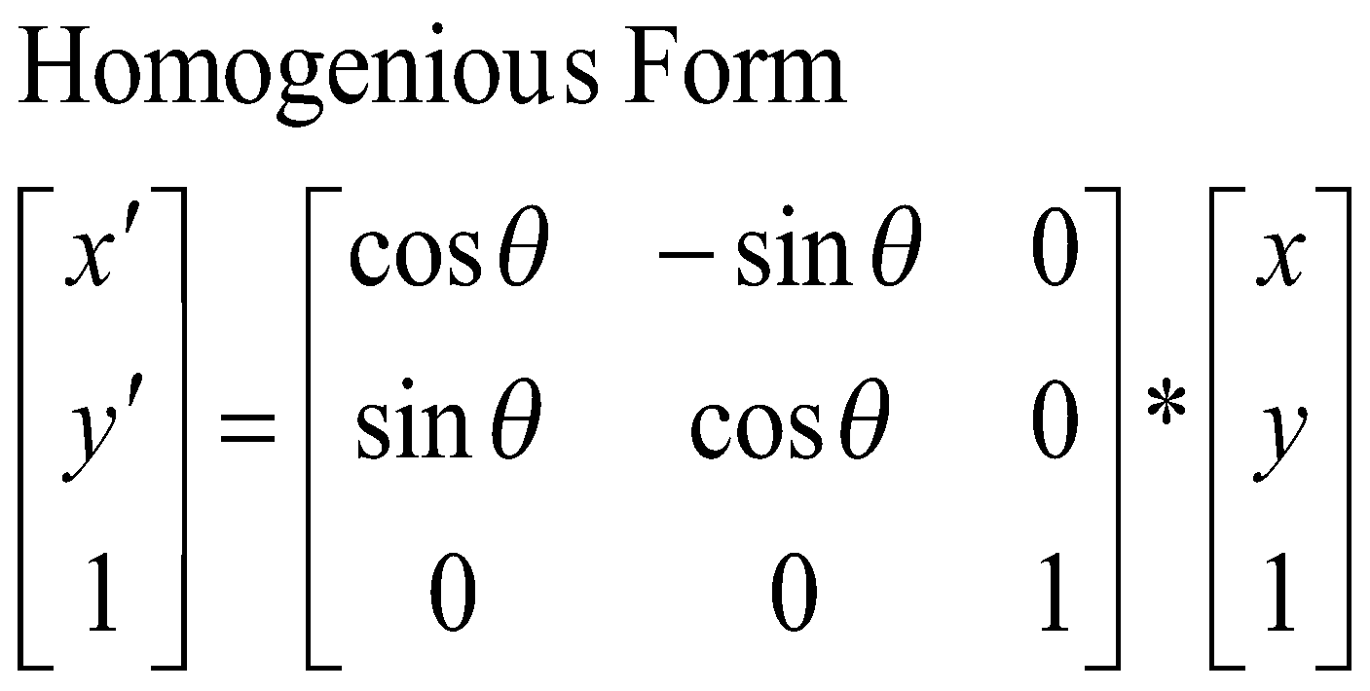
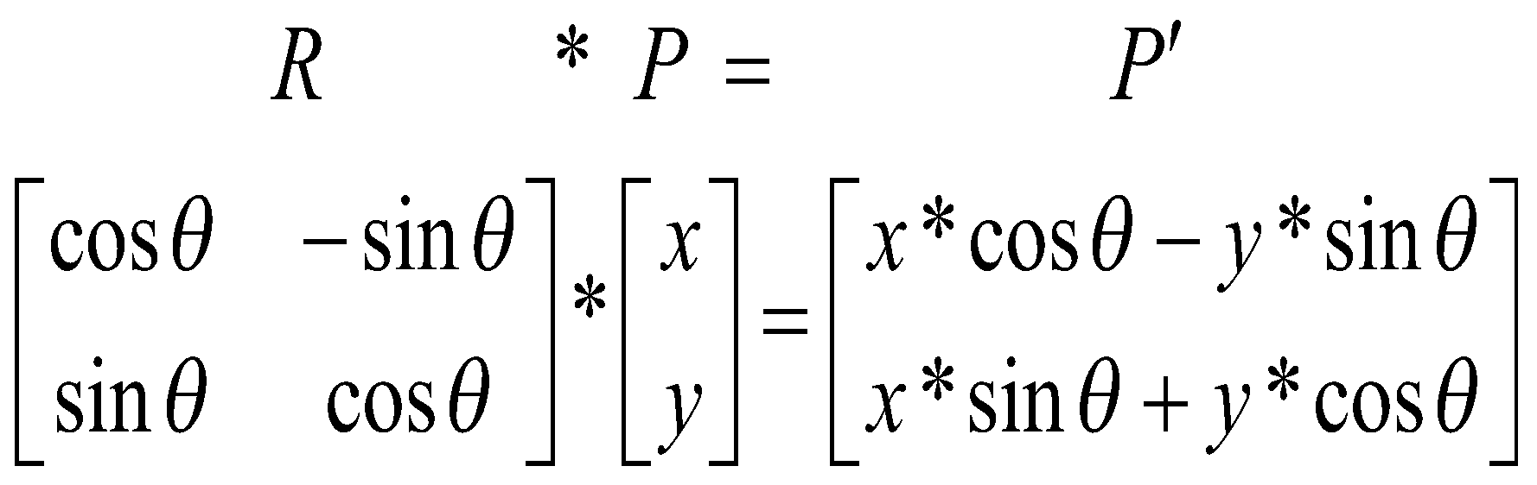
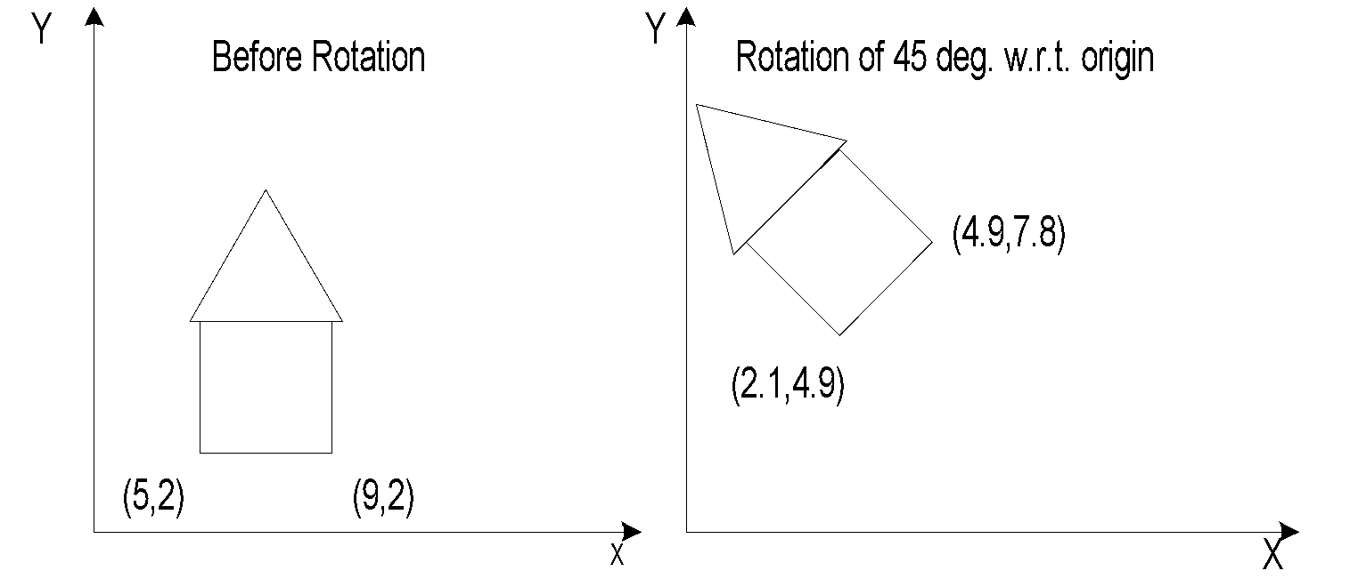
Rotation – 2D
‹#›

Slide 26
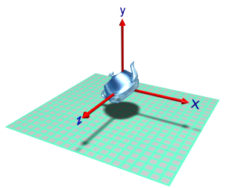
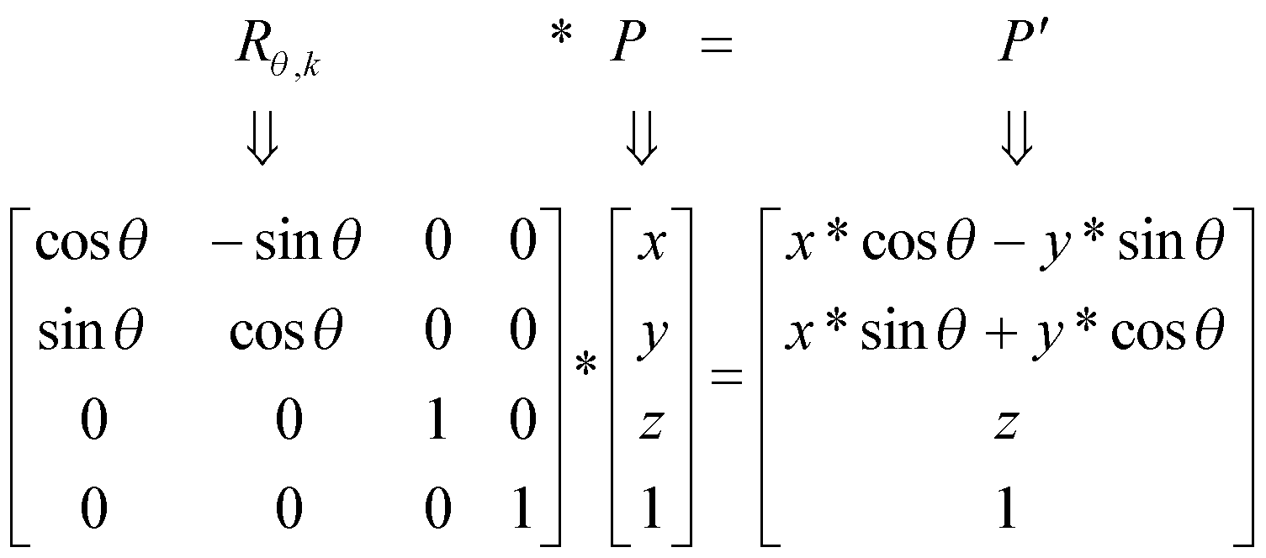
Rotation – 3D
For 3D-Rotation 2 parameters are needed
Angle of rotation
Axis of rotation
Rotation about z-axis:
‹#›

Slide 27
Rotation about Z axis: R_{θ,k}
y
p'
p
About z axis
θ
x
z
x'
y'
z'
1
cos θ
sin θ
0
0
-sin θ
cos θ
0
0
0
0
1
0
0
0
0
1
x
y
z
1
=
‹#›
Notes:
‹#›

Slide 28
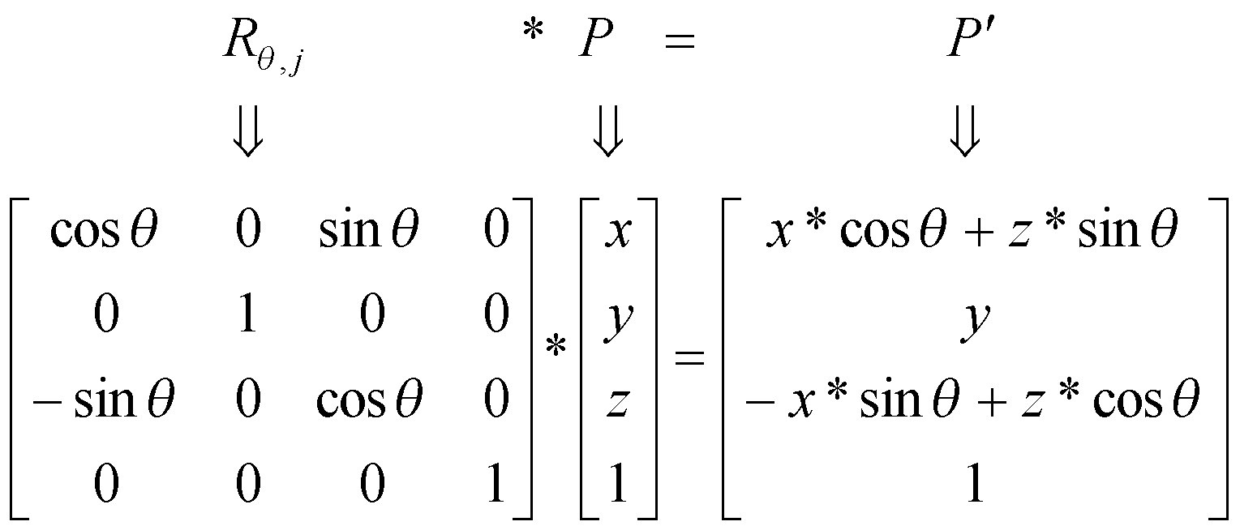
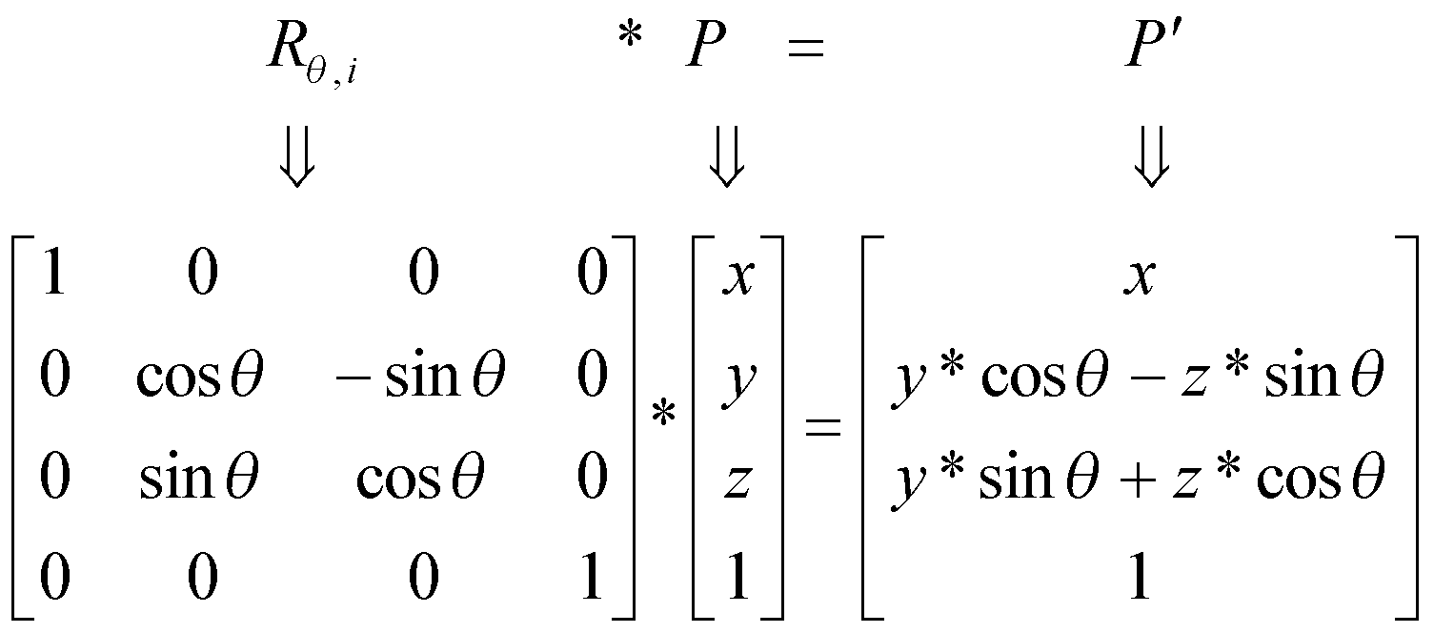
Rotation about Y-axis & X-axis
About y-axis
About x-axis
‹#›

Slide 29
Properties of rotation matrix
The columns of rotation matrix are unit vectors perpendicular to each other
The column vectors indicate where the unit vectors along the principal axes are transformed
The rows of rotation matrix are unit vectors perpendicular to each other
The row vectors indicate the vectors that are transformed into the unit vectors along the principal axes
The inverse of rotation matrix is its transpose
‹#›

Slide 30
Rotation about arbitrary axis
How to rotate around (kx, ky, kz), a unit vector on an arbitrary axis?
Example : Rotate 30 degree around vector 2i+1j+3k
Can it be found from some rotation around x axis, then some rotation around y axis, then z axis ?
‹#›

Slide 31
Finding the Rotation Matrix
Our previous method
Step 1,2 Perform two rotations so that a becomes aligned with the z-axis (two rotations are necessary)
Step 3 Do the required θ rotation around z-axis
Step 4,5 Undo the alignment rotations to restore a to its original direction
Alignment
Rotation
Trace Back
Trivial but you should be
careful when doing in hands
‹#›

Slide 32
Step 1,2
We now study a composite transformation
A_{V,N} = aligning a vector V with a vector N
To find the rotation matrix, we need to find A_{v,k}
‹#›

Slide 33
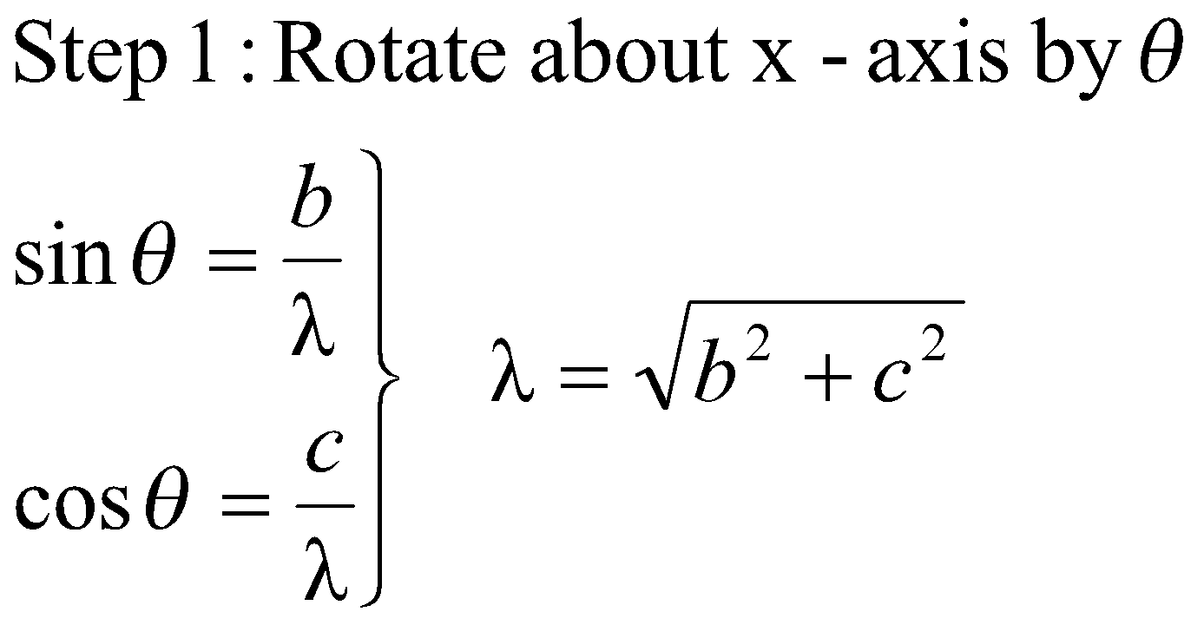
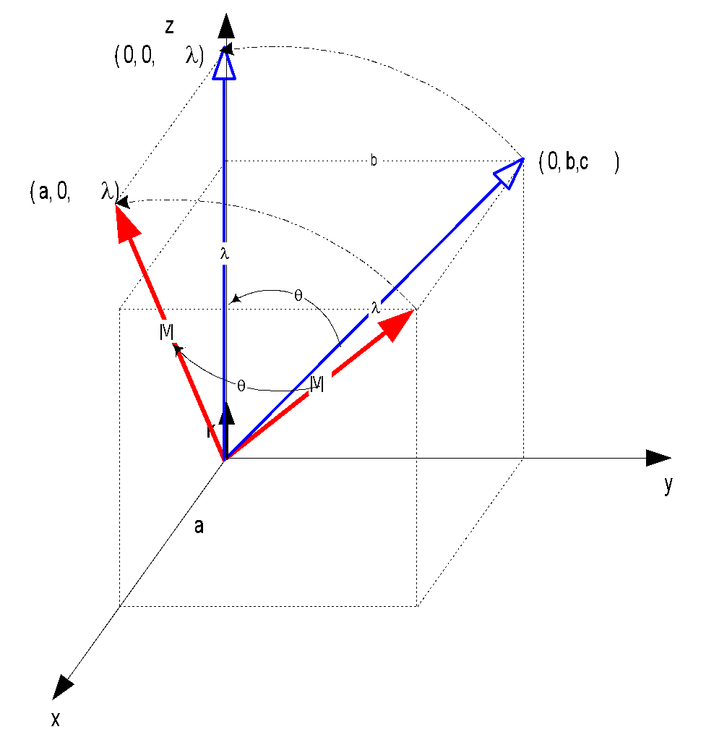
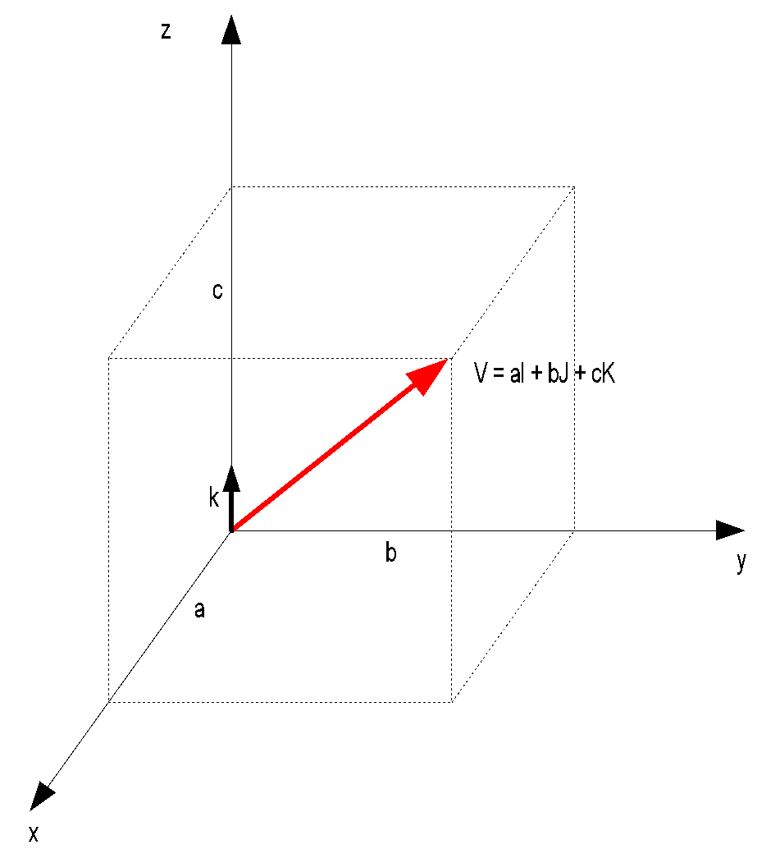
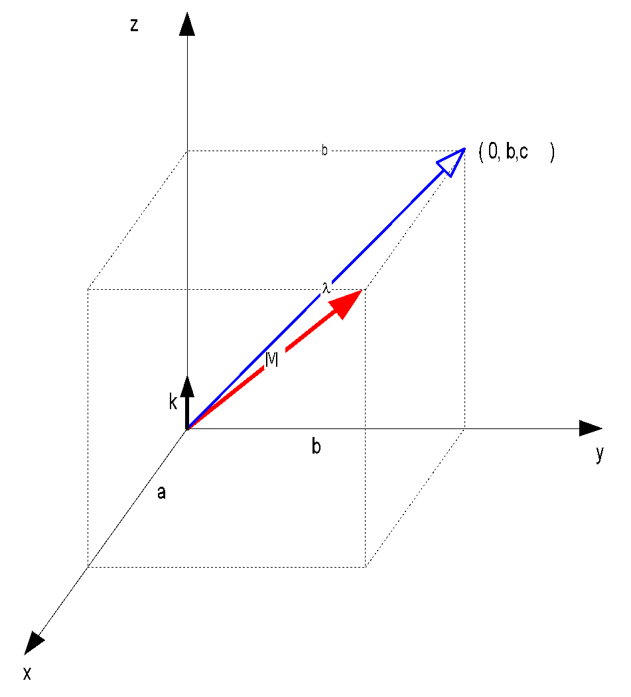
A_{V} : aligning vector V with k
A_{v} =
R_{θ,i}
‹#›

Slide 34
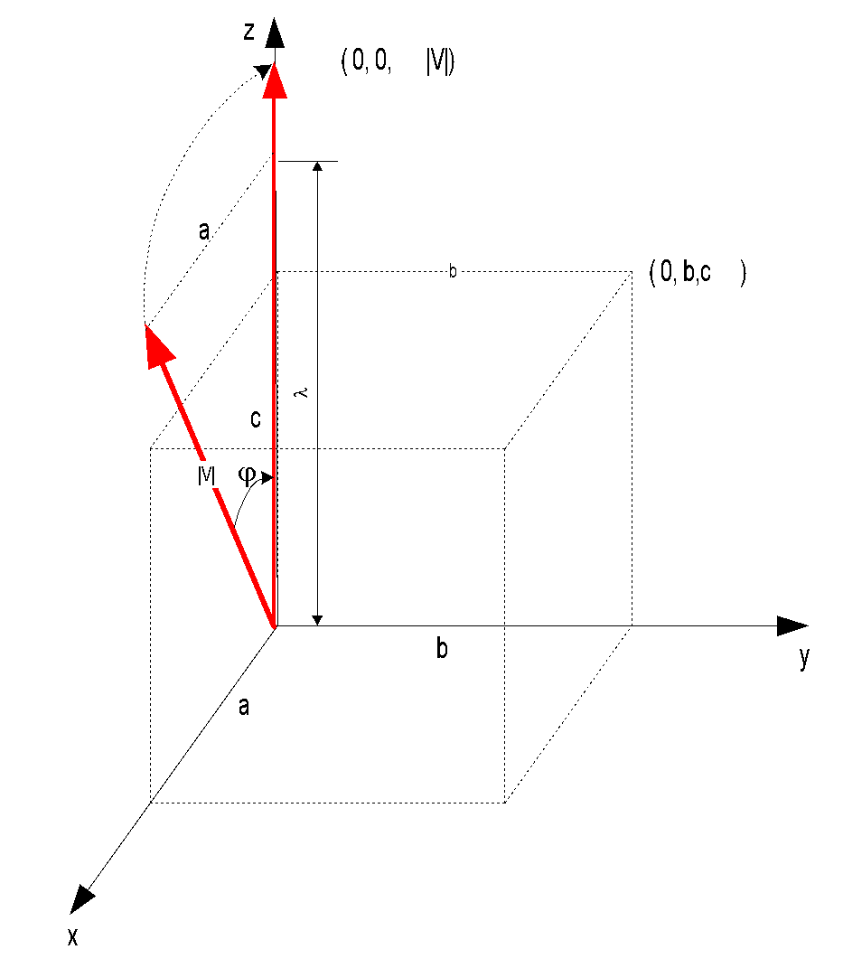
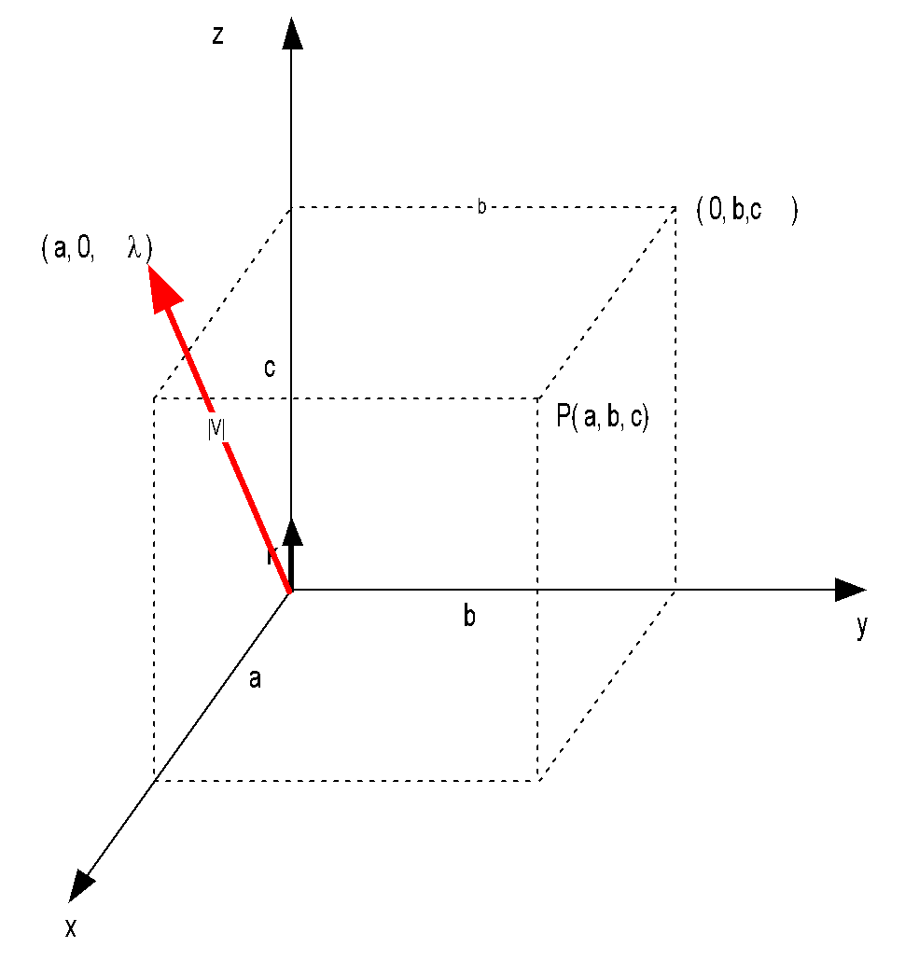
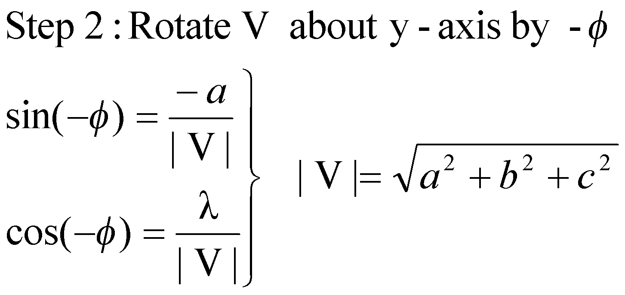
A_{V} : aligning vector V with k
A_{v} =
R_{-ϕ,j} *
R_{θ,i}
‹#›

Slide 35
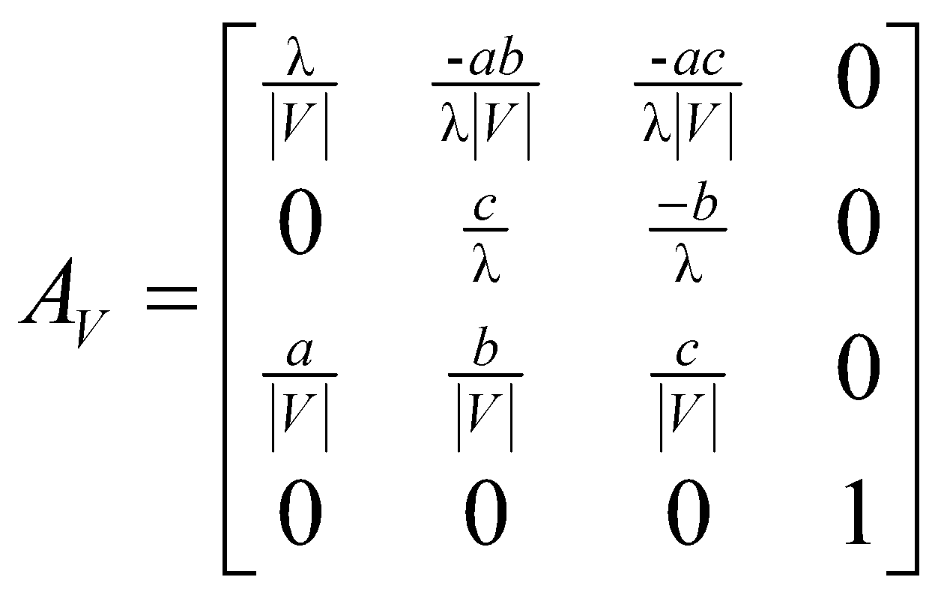
A_{V} : aligning vector V with k
A_{V}⁻¹ = A_{V}^{T}
A_{V,N} = A_{N}⁻¹ * A_{V}
‹#›

Slide 36
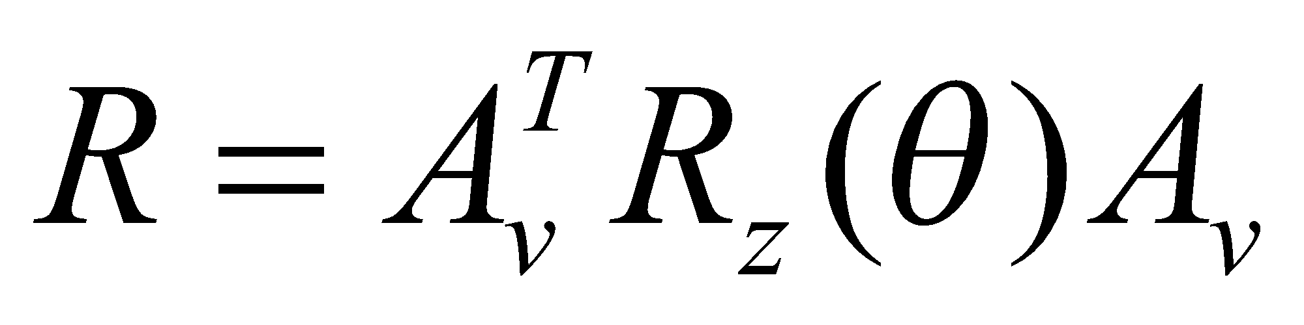
Finding the rotation matrix
Now we have done step 1,2 : A_{V}
For step 3, we have to rotate theta angle around z axis
Then take the inverse of step 1,2,
A_{V}⁻¹ = A_{V}^{T}
There are actually 5 rotations here.
‹#›

Slide 37
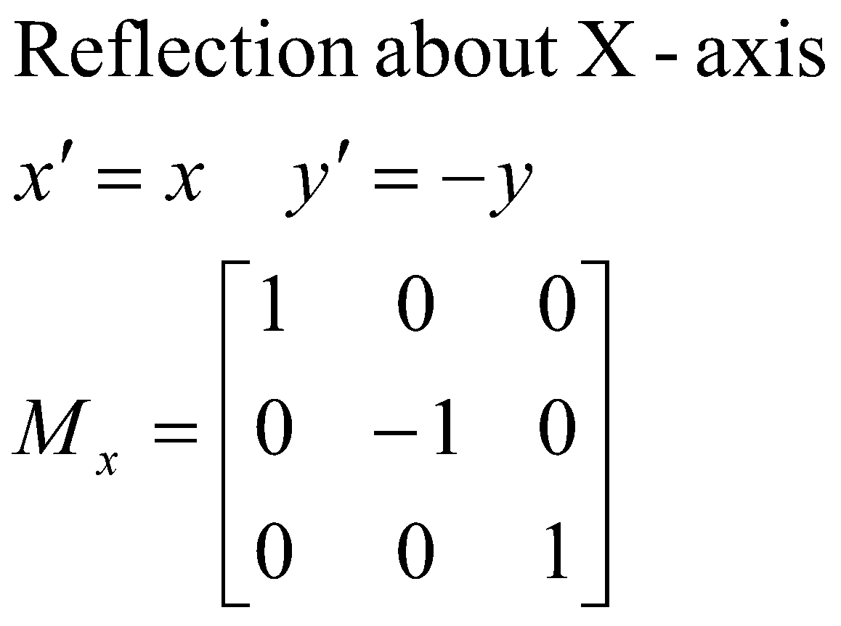
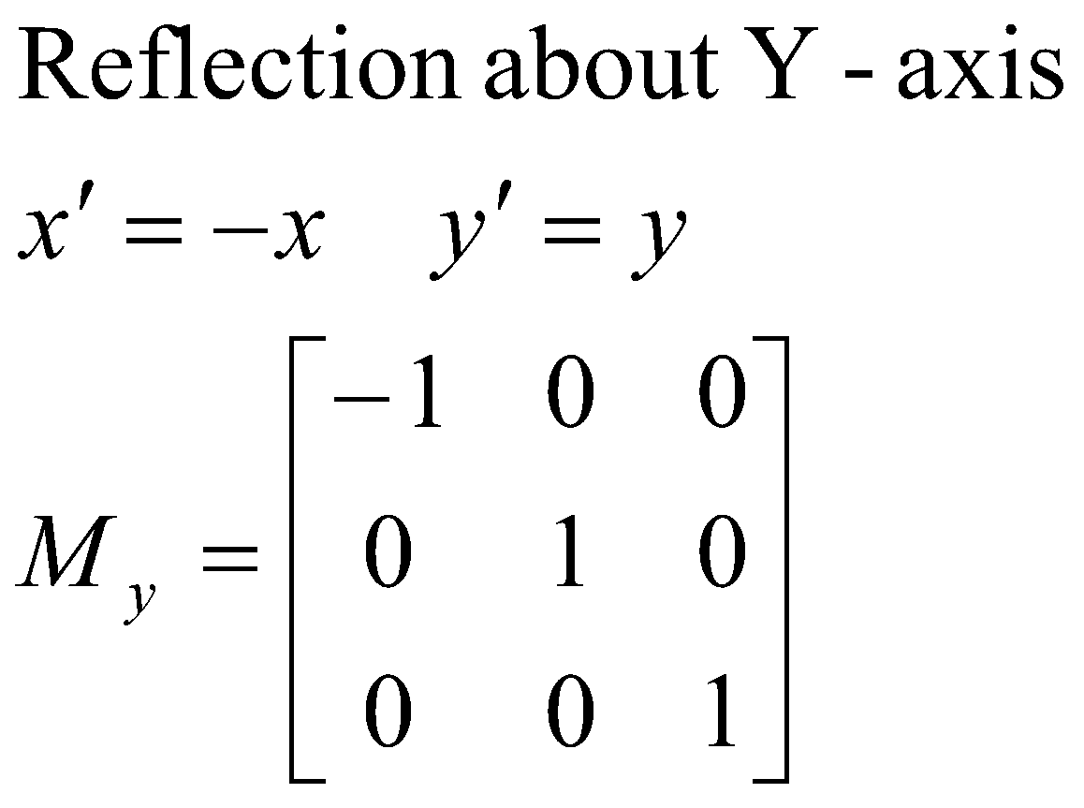
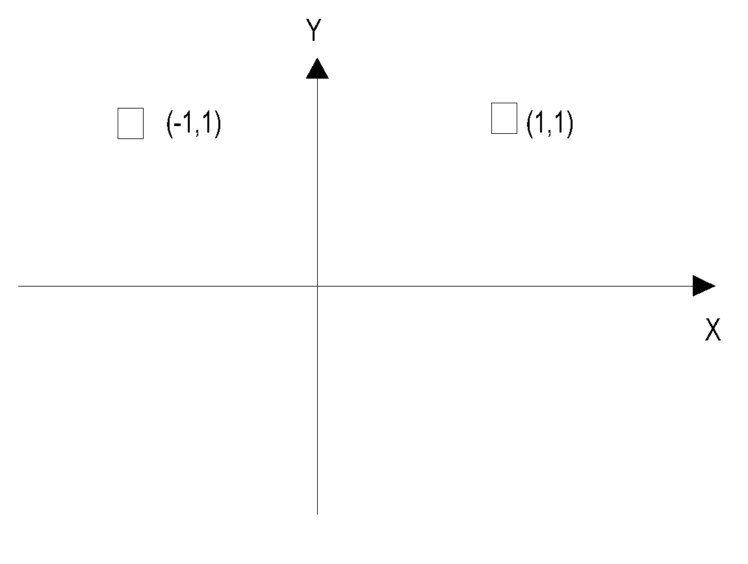

Mirror Reflection
‹#›

Slide 38

Reflection 3D
‹#›

Slide 39











Slide 40


Shearing Transformation
‹#›

Slide 41

Shear along Z-axis
z
x
y
‹#›

Slide 42


Shear along X-axis
‹#›

Slide 43


Shear along Y-axis
‹#›

Slide 44

Inverse Transforms
‹#›

Slide 45

Inverse Transformations
Shear : Sh⁻¹ = Sh_{-x}
x
‹#›

Slide 46
Composing Transformations
‹#›

Slide 47
How are transforms combined?
Scale then Translate
(5,3)
Scale(2,2)
(2,2)
Translate(3,1)
(1,1)
(3,1)
(0,0)
(0,0)
Use matrix multiplication: p' = T ( S p ) = TS p
0
0
1
0
2
0
2
1
0
0
1
0
0
1
0
0
1
3
1
2
0
0
0
2
0
3
1
TS =
=
Caution: matrix multiplication is NOT commutative!
‹#›
Notes:
‹#›

Slide 48
Non-commutative Composition
Scale then Translate: p' = T ( S p ) = TS p
(5,3)
Scale(2,2)
(2,2)
Translate(3,1)
(1,1)
(3,1)
(0,0)
(0,0)
Translate then Scale: p' = S ( T p ) = ST p
(8,4)
Translate(3,1)
(4,2)
Scale(2,2)
(6,2)
(1,1)
(3,1)
(0,0)
‹#›
Notes:
‹#›

Slide 49
Non-commutative Composition
Scale then Translate: p' = T ( S p ) = TS p
1
0
0
0
1
0
3
1
1
2
0
0
0
2
0
0
0
1
2
0
0
0
2
0
3
1
1
TS =
=
Translate then Scale: p' = S ( T p ) = ST p
0
0
1
2
0
0
2
0
0
1
0
0
1
3
1
2
0
0
2
6
2
0
0
1
0
0
1
ST =
=
‹#›

Slide 50
Combining Translations, Rotations
Order matters!! TR is not the same as RT (demo)
General form for rigid body transforms
We show rotation first, then translation (commonly used to position objects) on next slide. Slide after that works it out the other way
‹#›

Slide 51


Rotate then Translate
‹#›

Slide 52

Translate then Rotate
‹#›

Slide 53
Associativity of Matrix Multiplication
Create new affine transformations by multiplying sequences of the above basic transformations.
q = CBAp
q = ( (CB) A) p = (C (B A))p = C (B (Ap) ) etc.
matrix multiplication is associative.
To transform just a point, better to do q = C(B(Ap))
But to transform many points, best to do
M = CBA
then do q = Mp for any point p to be rendered.
For geometric pipeline transformation, define M and set it up with the model-view matrix and apply it to any vertex subsequently defined to its setting.
‹#›

Slide 54
Example Composite Transforms
‹#›

Slide 55
Rotation of θ about P(h,k): R_{θ,P}
Step 1: Translate P(-h,-k) to origin
Step 2: Rotate θ w.r.t to origin
Step 3: Translate (0,0) to P(h,k)
R_{θ,P}=
T(h ,k) *
R_{θ}*
T(-h ,-k)
‹#›

Slide 56
Translate
(-h,-k)
P(h,k)
P’(0,0)
Translate
(h,k)
Rotate(-90)
P(h,k)

Slide 57


Slide 58


Slide 59
Suppose, a composite transformation is defined as rotating 90 degree counterclockwise with respect to point (5, 5). Calculate the composite transformation matrix in homogeneous form. Then, find the new coordinates of the point (10, 10) after transformation.

Slide 60


Slide 61


So, the new coordinate of P is (0, 10)

Slide 62
Scaling of S_{a,b} about P(h,k): R_{S,P}
Step 1: Translate P(-h,-k) to origin
Step 2: Scale S_{a,b} w.r.t to origin
Step 3: Translate (0,0) to P(h,k)
R_{S,P}=
T(h ,k) *
S(a,b)*
T(-h ,-k)
‹#›

Slide 63
Translate
(-h,-k)
P(h,k)
P’(0,0)
Scale(1.5, 1.5)
Translate
(h,k)
P(h,k)

Slide 64


Slide 65

Suppose, a composite transformation is defined as scaling 2 times in both axis with respect to point (5, 5). Calculate the composite transformation matrix in homogeneous form. Then, find the new coordinates of the point (10, 10) after transformation.

Slide 66

So, the new coordinate of P is (15, 15)

Slide 67






Reflection about line L, M_{L}
P(x,y)
Translate(0,-b)
Rotate(-θ)
Reflect(x axis)
Rotate(θ)
Translate(0,b)

Slide 68
Reflection about line L, M_{L}
Step 1: Translate (0,-b) to origin
Step 2: Rotate -θ degrees
Step 3: Mirror reflect about X-axis
Step 4: Rotate θ degrees
Step 5: Translate origin to (0,b)
M_{L} =
T(0 ,b) *
R(θ) *
M _{x}*
R(-θ) *
T(0 ,-b)

Slide 69



Reflect the point (10, 5) with respect to the line
y=x+2.
New coordinate (3, 12)

Slide 70



Axis Angle Notation
Rodrigues Formula
‹#›

Slide 71

The Geometry of a Rotation
‹#›

Slide 72

The Geometry of a Rotation
‹#›

Slide 73

The Geometry of Rotation
‹#›

Slide 74

The Geometry of Rotation
So we find, the rotation vector is :
This is a vector equation, which is good
But, we need a matrix form also, to work easily.
Vector Form
Rodrigues
Formula
Matrix Form
‹#›

Slide 75


Rodrigues Formula
Vector and Matrix forms
How we find these equivalent matrix and vector forms ?
Check next slide
‹#›

Slide 76

Vector and Matrix algebra
‹#›

Slide 77

Cross product in Matrix Form
‹#›

Slide 78



Finding rotations from a rotation matrix
Given, R is a pure rotation matrix
Find axis of rotation K(k_{x},k_{y},k_{z})
and angle theta from R
Recall rodrigues formula, it gives R
Check that :
Trace(R ) = Sum of diagonal elements of the 3x3 rotation matrix
‹#›

Slide 79


Finding rotations from a rotation matrix
Check that :
‹#›

Slide 80
References
Chapter 4 and Chapter 6, Schaum's Outline of Computer Graphics (2nd Edition) by Zhigang Xiang, Roy A. Plastock
Chapter 5, Computer Graphics: Principles and Practice in C (2nd Edition) by James D. Foley, Andries van Dam, Steven K. Feiner, John F. Hughes
Chapter 6, Fundamentals of Computer Graphics, by Peter Shirley
‹#›

